Slide 1
Compassion Fatigue
Workbook

Slide 2
The Program
4 | Minutes | Welcome / Learning Points​
6 | Minutes | A Discussion
15 | Minutes | How The Build Up Happens
10 | Minutes | The Effects of Compassion Fatigue
10 | Minutes | The ABC of Prevention
10 | Minutes | Finding Connection
5 | Minutes | Questions
Notes:
2

Slide 3
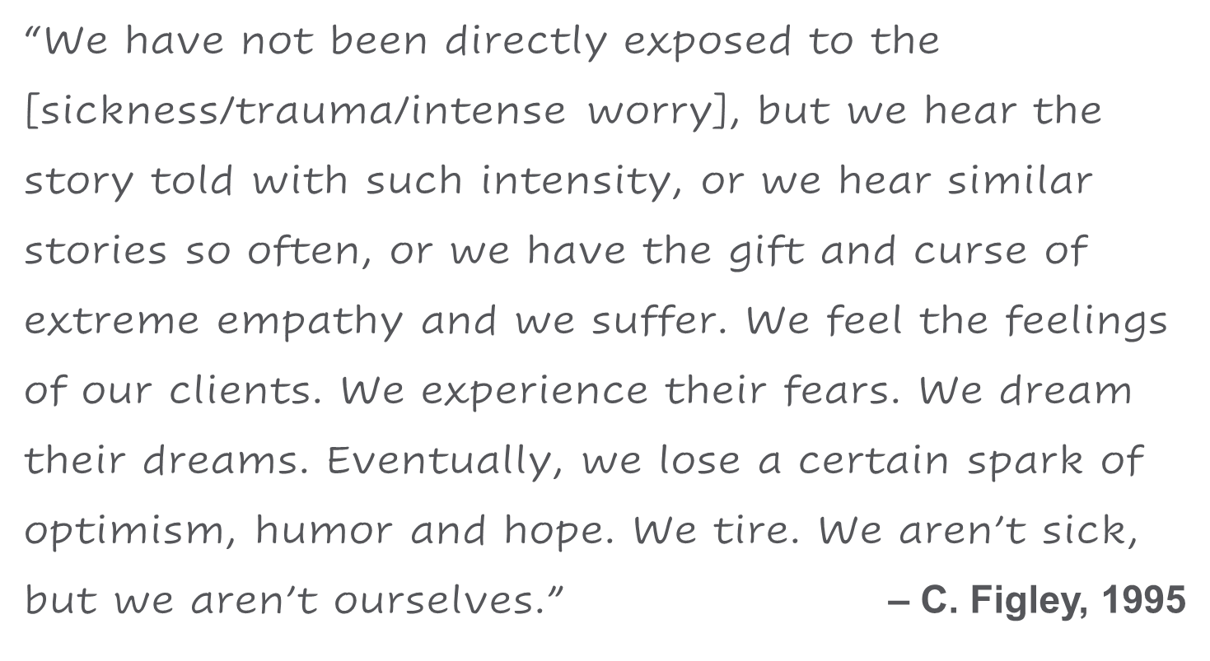
Consider This
Write your notes here
Notes:
3

Slide 4
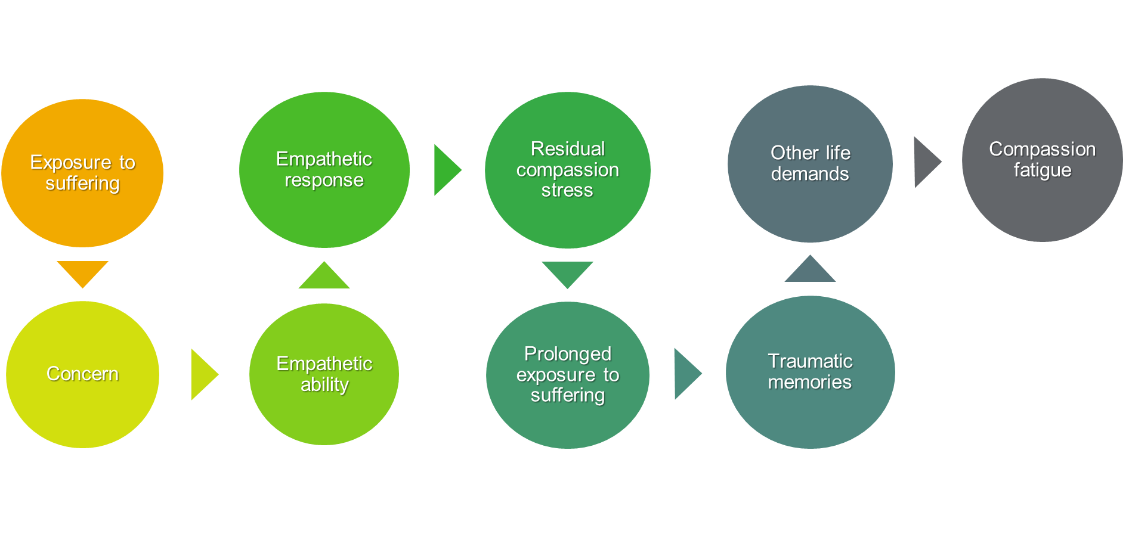
Compassion Fatigue Builds Up
Write your notes here
Notes:
4

Slide 5
Are You At Risk?
Question one
What satisfaction do you get from being able to help people?
Question two
How do you separate your personal life from your life as a helper?
Question three
What are your coping strategies after a ‘bad day’?
Write your notes here
Notes:
5

Slide 6
ABC of Prevention
Awareness
Balance
Connection
Notes:
6

Slide 7
About Professional Support
You may consider seeking professional support if you experience any of the following:
Sleep problems
Performance issues at work
Relationship difficulties with family or friends
Loss of interest in hobbies you normally enjoy
Lack of care about normal everyday work tasks
Excessive anxiety or worrying more than normal
Feeling overwhelmed or sad for more than two weeks
A noticeable change in appetite, eating too little or too much
Behavior and coping methods have become harmful to yourself or others, whether that is through aggressive behavior or unhealthy habits, such as drinking too much alcohol or taking drugs
Thoughts of harm to self and/or others
Keep in mind some of these conditions warrant more urgent professional help and you should seek support if you are unsure.
Your Employee Assistance Program (EAP) is available to all employees and their covered dependents and may include some free counseling sessions per issue, per year. Please check with your employer or your health plan for details.
Notes:
7

