Slide 1
How To Beat Fatigue and Sleep Better
Workbook

Slide 2
The Program
Slide 2
Welcome
About Sleep
Effects of a Lack of sleep
Assessing Your Sleep
Behavioral Factors
Environmental Factors
Other Factors That Disrupt Our Sleep
Close
Notes:
2

Slide 3
Learning Points
Slide 3
Participants will:
Learn more about sleep and its importance in our lives.
Assess your own sleep and create an action plan to help you get better sleep.
Identify resources to help.
Notes:
3

Slide 4
If You Don’t Sleep Well, You Are Not Alone
Slide 4
We have all probably experienced a sleepless night from time to time. For some people this occurs more often than not:
50-70 million adults in the U.S. have a sleep disorder.
37% of 20-39 year-olds report short sleep duration.
40% of 40-59 year-olds report short sleep duration.
Insomnia is the most common sleep disorder.
Notes:
4

Slide 5
What Happens When We Sleep?
Slide 5
Non REM 1
Muscles active.
Eyes roll, open, and close.
May feel like falling.
Non REM 2
Gradually harder to wake.
Alternate muscle activity and inactivity.
Heart rate and temperature drop.
Non REM 3 and 4
These 2 phases are sometimes combined in scientific theory.
May feel disoriented if awoken.
Repair and regenerate tissue.
Build bone and muscle.
Strengthen immune system.
REM
Most muscles are paralysed.
Hardest phase to awake from.

Slide 6
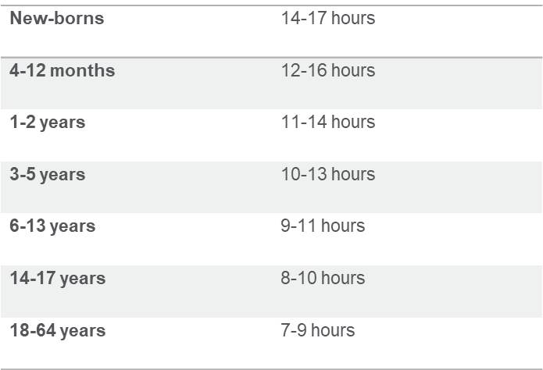
How Much Sleep Do We Need?
Slide 6
The amount of sleep we need varies by person but the following recommendations by the Centers For Disease Control (CDC), provide some guidelines:
How many hours of sleep per night do you and your family members get?
Does it match the guidelines?
If not, why not?

Slide 7
Too Little Sleep/Too Little Good Sleep
Slide 7
We know that a lack of sleep or poor sleep has many negative effects on our health and life, such as:
Increased potential for accidents.
Impaired cognitive processes including attention, alertness, concentration, and problem solving.
Can lead to serious health issues including heart disease, high blood pressure, stroke, and diabetes.
May contribute to symptoms of depression.
Increased hunger and appetite leading to weight gain.
How does too little or disrupted sleep affect you?

Slide 8
About Your Sleep
Slide 8-9
It is important to assess your own sleep patterns:
Do you have trouble going to sleep?
How often?
Do you have trouble staying asleep?
How many times per night do you wake up?
Do you have trouble getting up? Why?

Slide 9
Building Better Sleep Habits
Slide 10
The quality of our sleep can be affected by several things:
Environmental Factors.
Behavioral Factors.
Underlying Medical Issues.

Slide 10
Sleep Diaries
Slide 11
Keeping a sleep diary can help you identify what may be getting in your way of a good night sleep. Keep a daily record of the following information:
What time did you go to bed?
When did you fall asleep?
When did you wake up?
Did you nap that day? How long? When?
Did you exercise? How much?
Did you drink alcohol? How much?
How many caffeinated beverages did you have?
How sleepy did you feel that day?
How productive were you?
Other notes:

Slide 11
Sleep Consistency
Slide 12
Maintain a consistent bed time and wake time schedule.
Our bodies follow a circadian rhythm.
Synchronize with your melatonin wave.
Avoid the snooze button.
What is your normal bedtime?
What is your normal wake time?
Do you snooze? How long? Why?
Do you try to make up for lost sleep on the weekends?

Slide 12
Behavioral Factors
Slide 13- 14
Behavioral changes to help with sleep:
Avoid going to bed hungry or overeating close to bedtime.
Limit alcohol.
Exercise regularly, preferably at least three hours before bed.
Don’t smoke, especially in the evening hours.
Avoid or minimize caffeinated beverages, especially later in the day.
Limit screen time – decrease light stimulation from TV, phone, and computer before bed.
Journal.
Listen to relaxing music.
Read.

Slide 13
Behavioral Factors - Sleep Routines
Slide 15
Sleep routines are not just for babies.
You are just a grown up baby!
For a good night’s sleep, you need to wind down from your busy day.
What is your sleep routine?
What is your current sleep routine?

Slide 14
Create a Bedtime Routine
About an hour before you want to be asleep, start your wind down routine. A routine trains your brain to switch off and associates your bed with sleep. Aim to fill that time with activities that put your mind at ease and don’t require a great deal of attention or energy. Consider these ideas:
Take a nice warm shower or bath.
Put on comfortable sleepwear.
Drink some herbal tea or warm milk.
Engage in a relaxing hobby.
Read or listen to an audio book.
Listen to calming music.
Practice relaxation techniques like deep breathing, meditation, mindfulness or visualizations, yoga, tai chi, stretches.
Journal.
Aromatherapy.

Slide 15
Behavioral Factors - Electronics
Slide 16
Our gadgets are inhibitors of sleep. They stimulate us with a constant rush of information and activity. Even when they are silenced, our brain is still affected by them and stays “on.”
Our gadgets inhibit our sleep, they stimulate us.
Blue light suppresses the release of melatonin.
Delays and reduces REM sleep.
Notes:
15

Slide 16
Disrupted Sleep - Waking Up During the Night
Slide 17
Some people have no trouble falling asleep at bedtime but then find themselves waking up during the night. Sometimes we can get ourselves back to sleep quickly, other nights we can’t. Laying in bed tossing and turning, getting worried and anxious about not being able to sleep will not help matters. If you wake up during the night and can’t go back to sleep, either:
Get up for 15- 20 mins and repeat your going to bed routine.
Try to meditate in bed.
Use sleep apps.
Have a plan to avoid worry.
Do a gratitude exercise.
Notes:
16

Slide 17
Environmental Factors
Slide 18
Your sleep environment will have a huge effect on your quality of sleep.
Picture your bedroom right now, what does it look like?
How does it make you feel?

Slide 18
Environmental Factors - Light
Slide 19
Light suppresses sleep hormones.
Blue light is the worst, it inhibits melatonin production.
Red light has the least effect.
Lots of light in the day will help sleep at night.
For a good night’s sleep, keep your bedroom as dark as possible. Darkness promotes melatonin to be released. Even light from a digital alarm clock can be disruptive to our sleep cycle. Use blackout shades or wear an eye mask.

Slide 19
Environmental Factors - Temperature
Slide 20
Temperature also affects our quality of sleep. Keep your bedroom well ventilated. Use a humidifier if necessary.
54-75 degrees Fahrenheit is the ideal room temperature for sleep.
Varies between individuals.
Body temperature drops about 4 hours into sleep.

Slide 20
Additional Environmental Factors
Slide 21
Unresolved conflicts or worries may be keeping you awake. The sleep diary mentioned earlier will help you to identify if you have thoughts running through your head over and over again which do not allow you to fully relax. The relaxation techniques, gratitude exercises, and journaling activities can help work through these issues.
Children/Babies can most definitely throw off our sleep cycles. Parents of babies and very young children would benefit from sleep training their little ones to minimize night waking. This training is usually challenging for a few weeks but ultimately will lead to better sleep for your children and you.
Snoring can keep you up as well as disrupt the sleep of a partner. Snoring may be the result of medical issues and sleep disorders. Consulting with your physician can help identify the cause and offer relief.

Slide 21
Your Action Plan for Better Sleep
List three things you will do to improve your sleep:
1.
2.
3.

Slide 22
About Professional Support
You may consider seeking professional support if you experience any of the following:
Sleep problems.
Performance issues at work.
Relationship difficulties with family or friends.
Loss of interest in hobbies you normally enjoy.
Lack of care about normal everyday work tasks.
Excessive anxiety or worrying more than normal.
Feeling overwhelmed or sad for more than two weeks.
A noticeable change in appetite, eating too little or too much.
Behavior and coping methods have become harmful to yourself or others, whether that is through aggressive behavior or unhealthy habits, such as drinking too much alcohol or taking drugs.
Thoughts of harm to self and/or others.
Keep in mind some of these conditions may warrant more urgent professional help and you should seek support if you are unsure.
Your Employee Assistance Program (EAP) is available to all employees and their covered dependents and may include some free counseling sessions per issue, per year. Please check with your employer or your health plan for details.
Citations
American Psychological Association: How to choose a psychologist.
http://www.apa.org/helpcenter/choose-therapist.aspx.
Helpguide.org: Depression Symptoms and Warning Signs.
https://www.helpguide.org/articles/depression/depression-symptoms-and-warning-signs.htm.
Helpguide.org: Suicide Prevention.
https://www.helpguide.org/articles/suicide-prevention/suicide-prevention.htm.
Notes:
22

